Slide 1
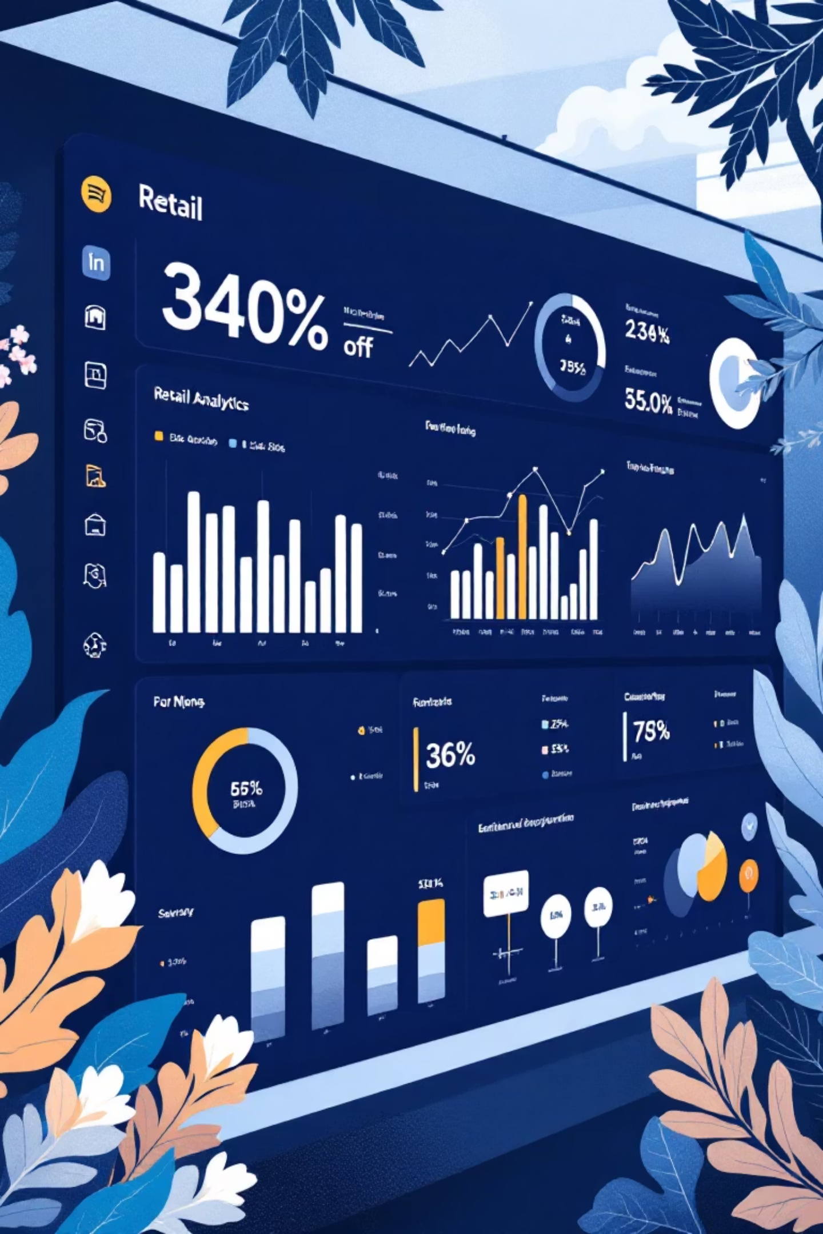
Customer Shopping Behaviour Analysis
Uncovering insights from 3,900 purchases to guide strategic business decisions

Slide 2
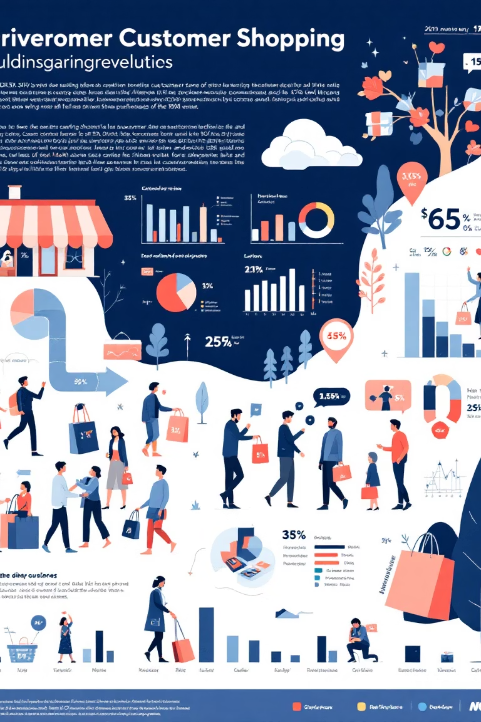
Dataset Overview
3,900
18
50
Total Purchases
Data Points
Locations
Transactions analysed
Features per purchase
Geographic coverage
25
Products
Items tracked
Comprehensive dataset covering demographics, purchase details, and shopping behaviour across multiple categories

Slide 3
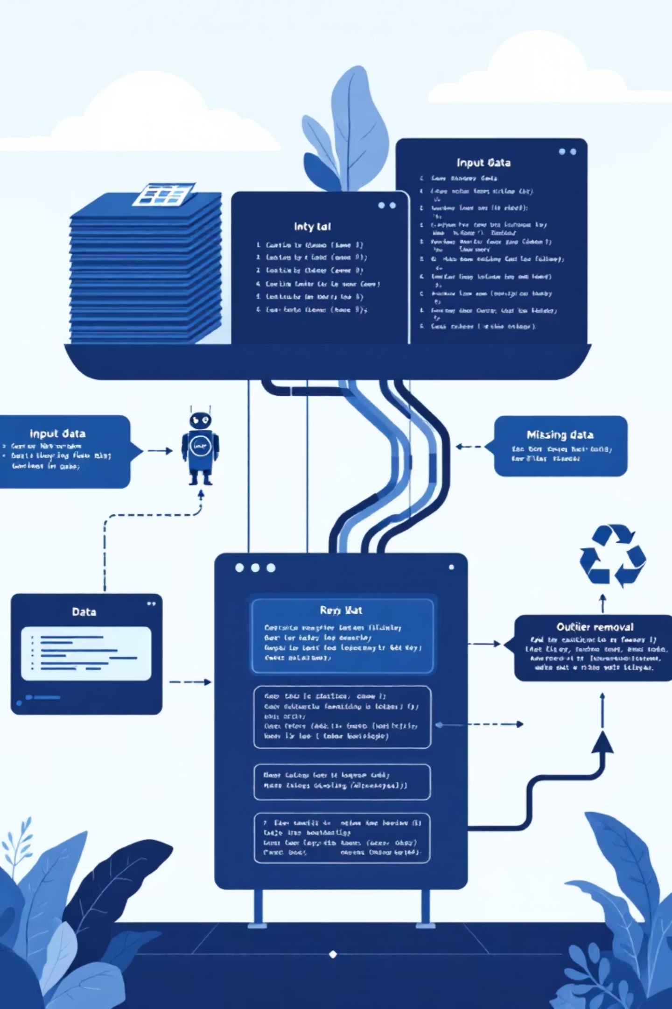
Data Preparation Journey
01
Data Loading
Imported dataset using pandas, explored structure with df.info()
02
Cleaning
Imputed 37 missing review ratings using category medians
03
Feature Engineering
Created age groups and purchase frequency metrics
04
Database Integration
Connected to PostgreSQL for advanced SQL analysis

Slide 4
Revenue Insights
Gender Revenue Split
Age Group Performance
Male customers drive 68% of total revenue
Young Adults: £62,143
Middle-aged: £59,197
68%
Adults: £55,978
Male
Seniors: £55,763
£157,890 revenue
32%
Female
£75,191 revenue

Slide 5
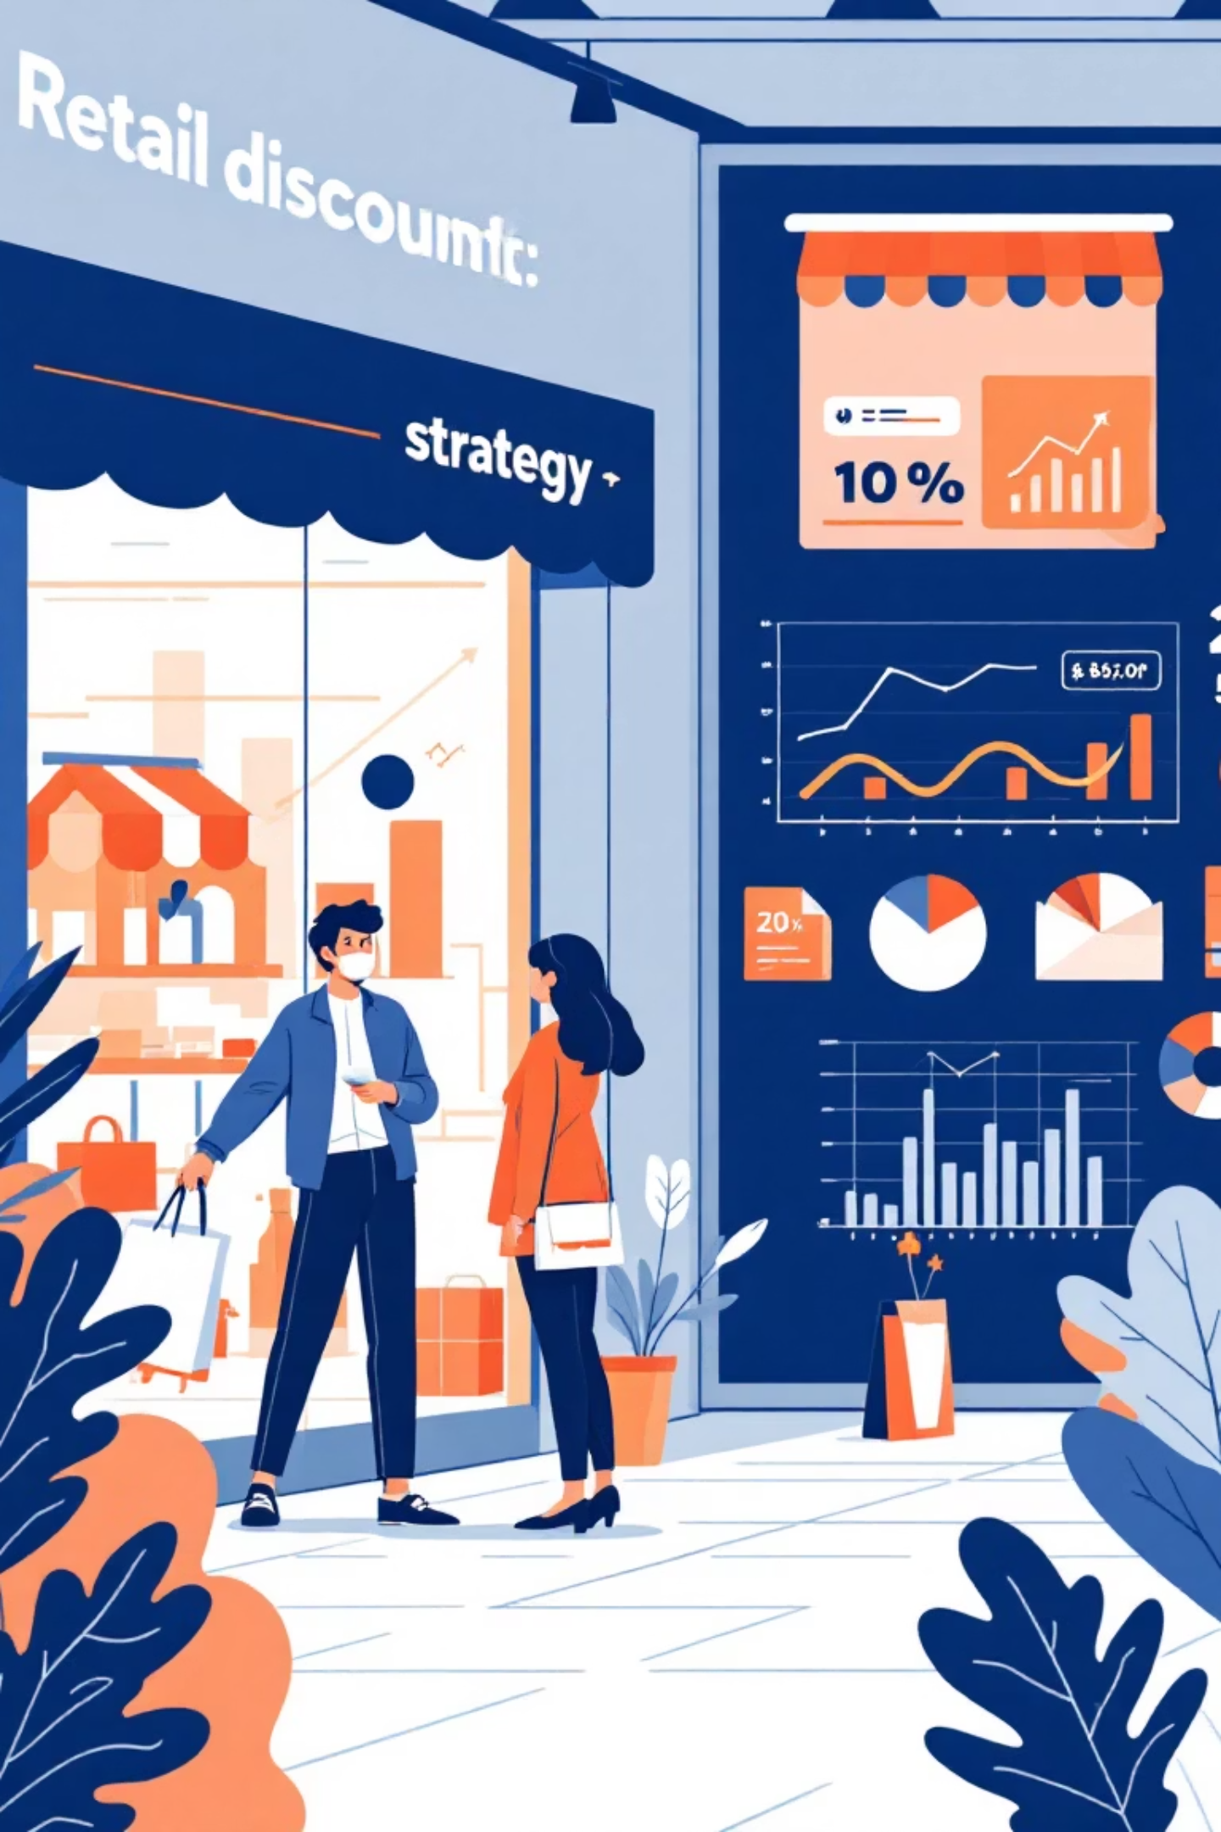
Discount Strategy Analysis
High-Value Discount Users
Discount-Dependent Products
839 customers used discounts but spent above average
Hats (50%), Sneakers (49.66%), Coats (49.07%)
Strategic Opportunity
Balance sales boosts with margin control

Slide 6
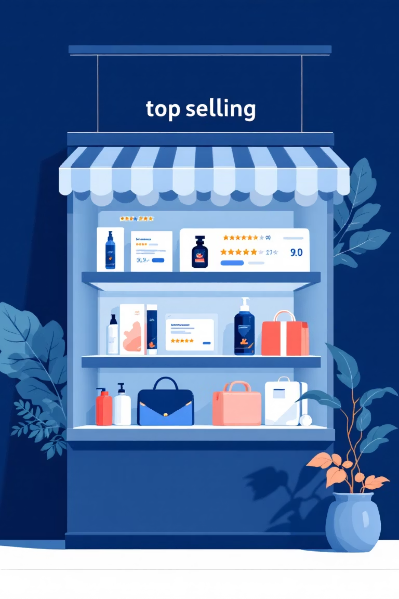
Product Performance Leaders
Top Rated Products
Best Sellers by Category
Gloves (3.86 rating)
Accessories: Jewellery (171 orders)
Sandals (3.84 rating)
Boots (3.82 rating)
Clothing: Blouse & Pants (171 orders)
Hat (3.80 rating)
Skirt (3.78 rating)
Footwear: Sandals (160 orders)
Outerwear: Jacket (163 orders)

Slide 7




Customer Segmentation
Returning
701 customers (18%)
Growth opportunity
Loyal
3,116 customers (80%)
Core revenue drivers
New
83 customers (2%)
Acquisition focus
958 repeat buyers (>5 purchases) show higher subscription rates

Slide 8
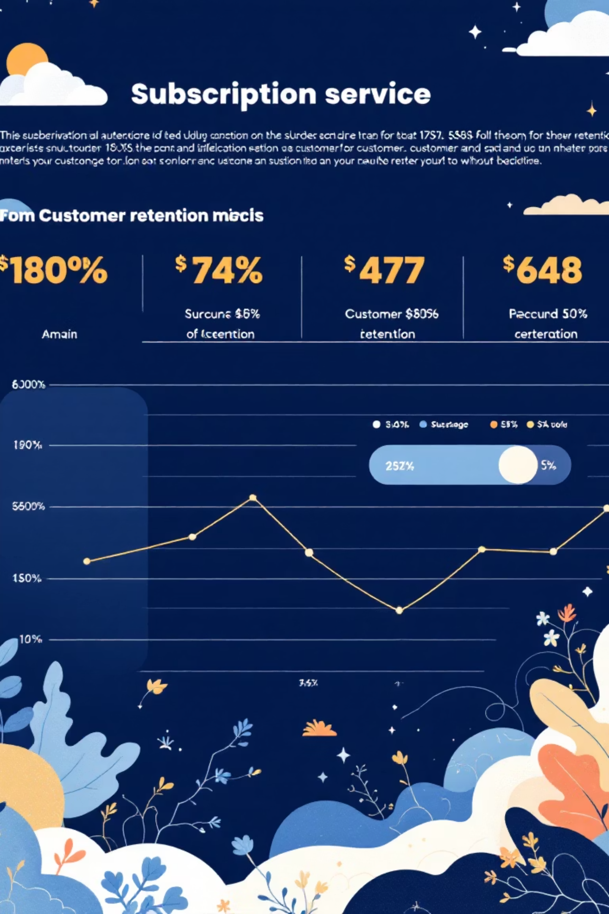

Subscription Behaviour
Subscribers
1,053 customers
Average spend: £59.49
Total revenue: £62,645
Non-Subscribers
2,847 customers
Average spend: £59.87
Total revenue: £170,436
Shipping preference: Express users spend £60.48 vs £58.46 for Standard

Slide 9

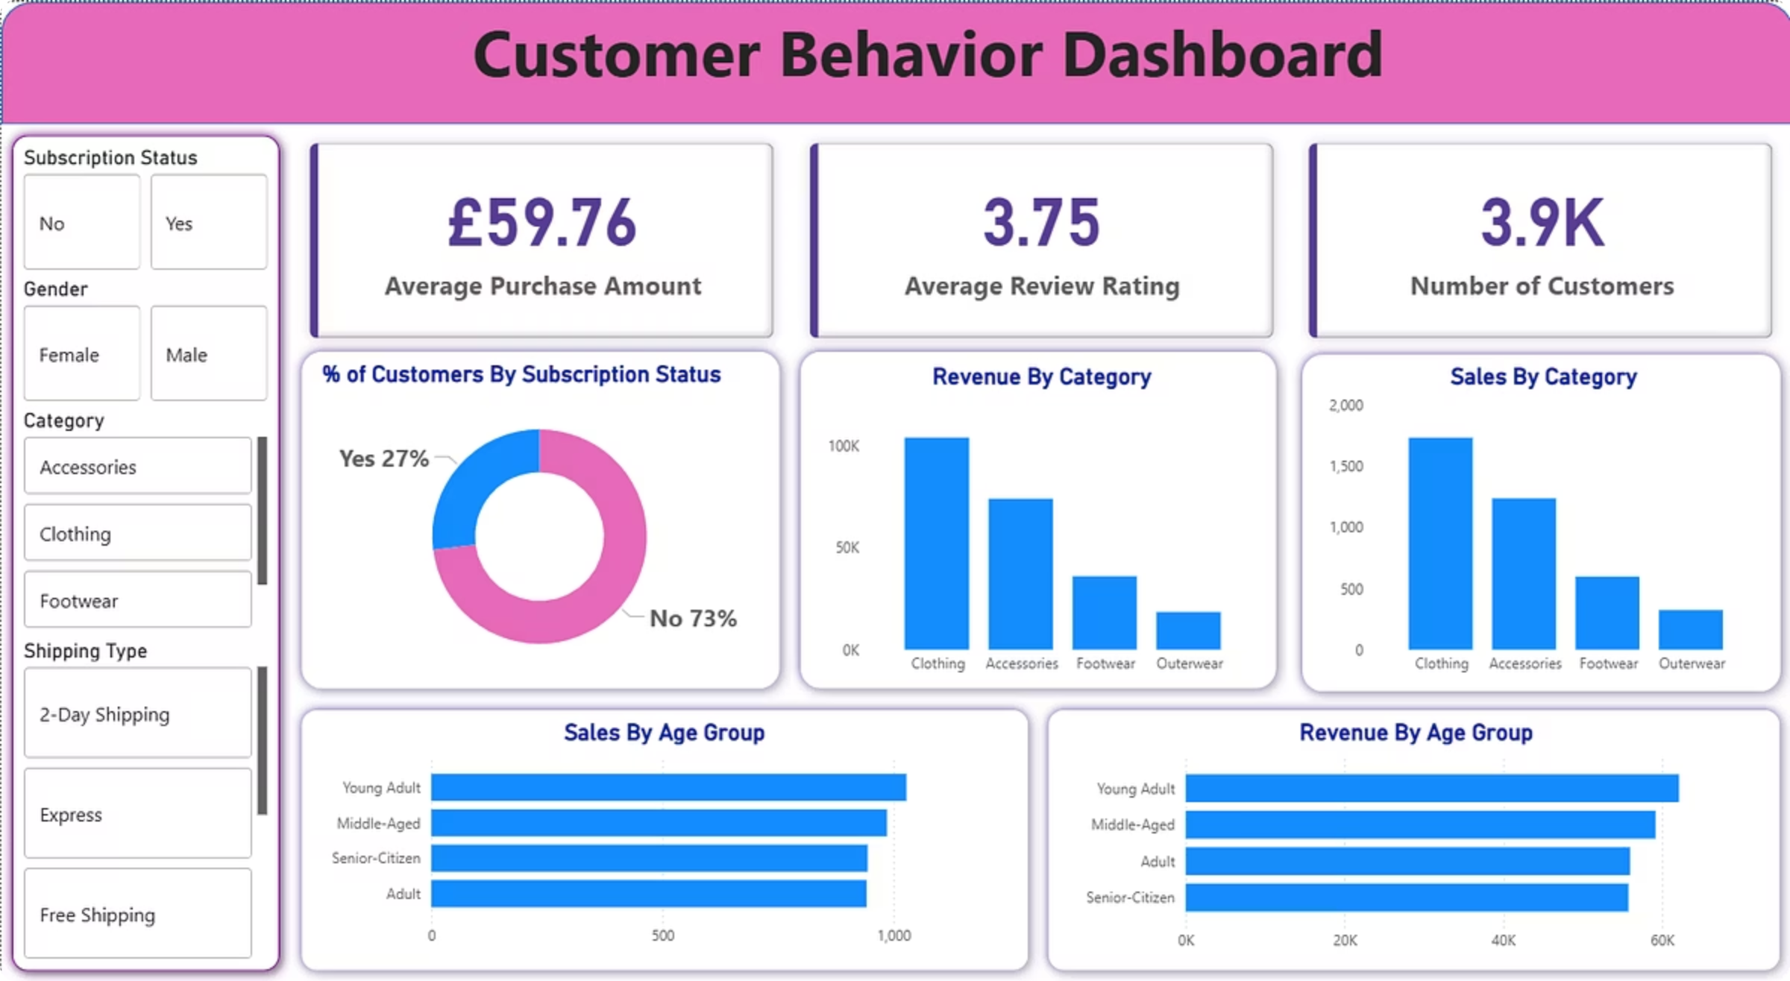
Power BI Dashboard
Interactive visualisation bringing together customer demographics, purchase patterns, and revenue insights for strategic decision-making

Slide 10
Strategic Recommendations
Boost Subscriptions
Loyalty Programmes
Targeted Marketing
Promote exclusive benefits to convert high-value customers
Reward repeat buyers to grow loyal segment
Focus on high-revenue age groups and express shipping users
Product Positioning
Discount Policy
Highlight top-rated items in campaigns
Balance sales growth with margin protection

